Slide 1

BOOK RECOMMENDER SYSTEM AND BOOK SHOP
Project by :– PIYUSH RAMGIRWAR

Slide 2
Tech stack
Python (Pandas)
Selenium
Beautiful Soup
Machine Learning
HTML
CSS
Flask

Slide 3
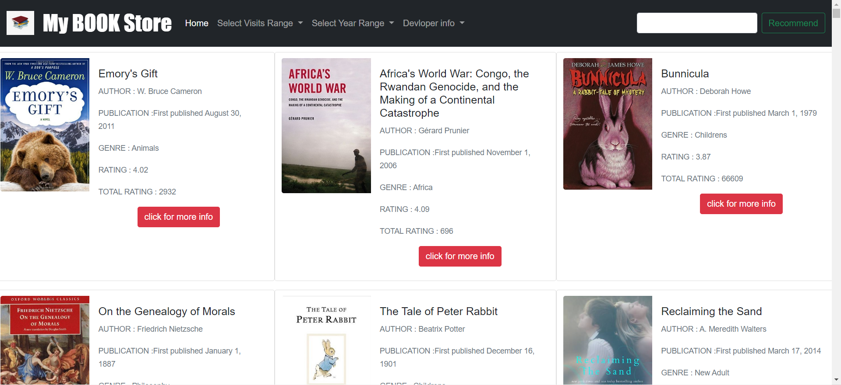
Main Webpage

Slide 4
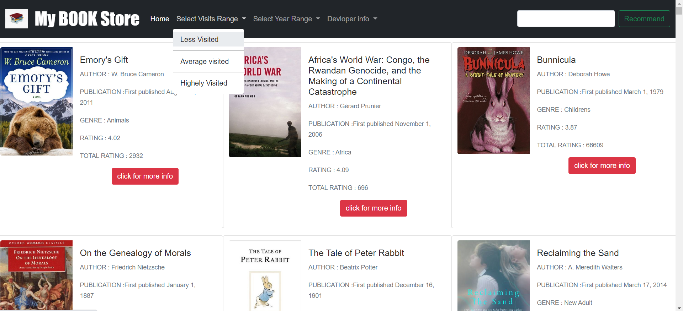
Books as per visits

Slide 5
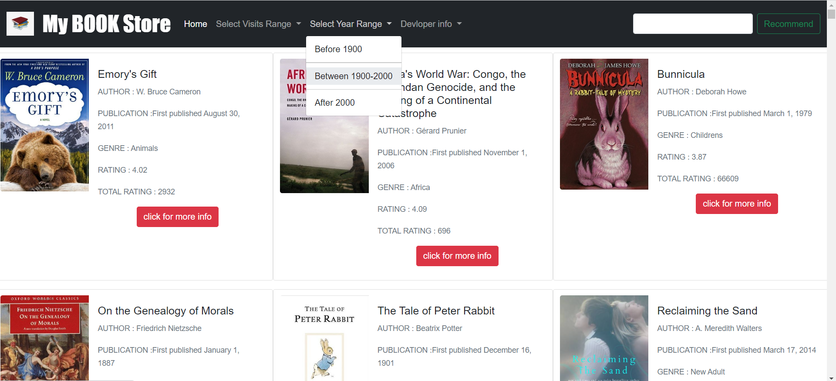
Books As Per Published Year

Slide 6

Book Recommender
Click on recommend button
Enter Book Name

Slide 7
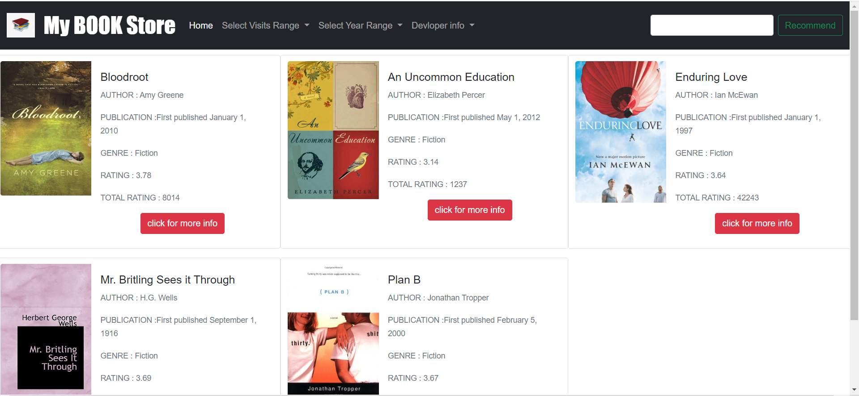
Result Page(Recommended Books)

Slide 8
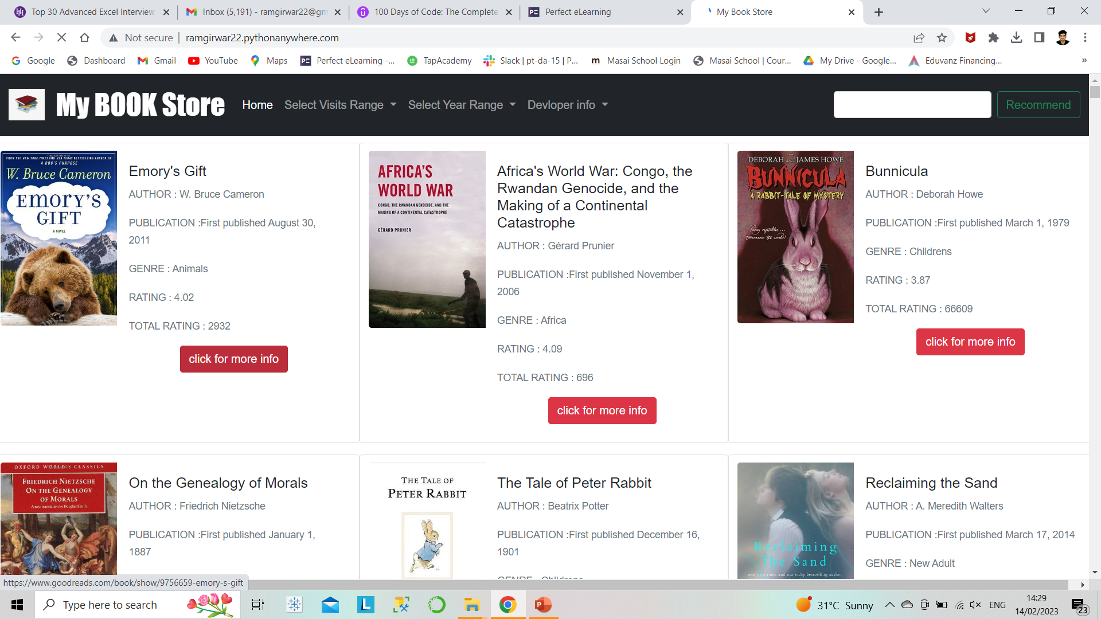
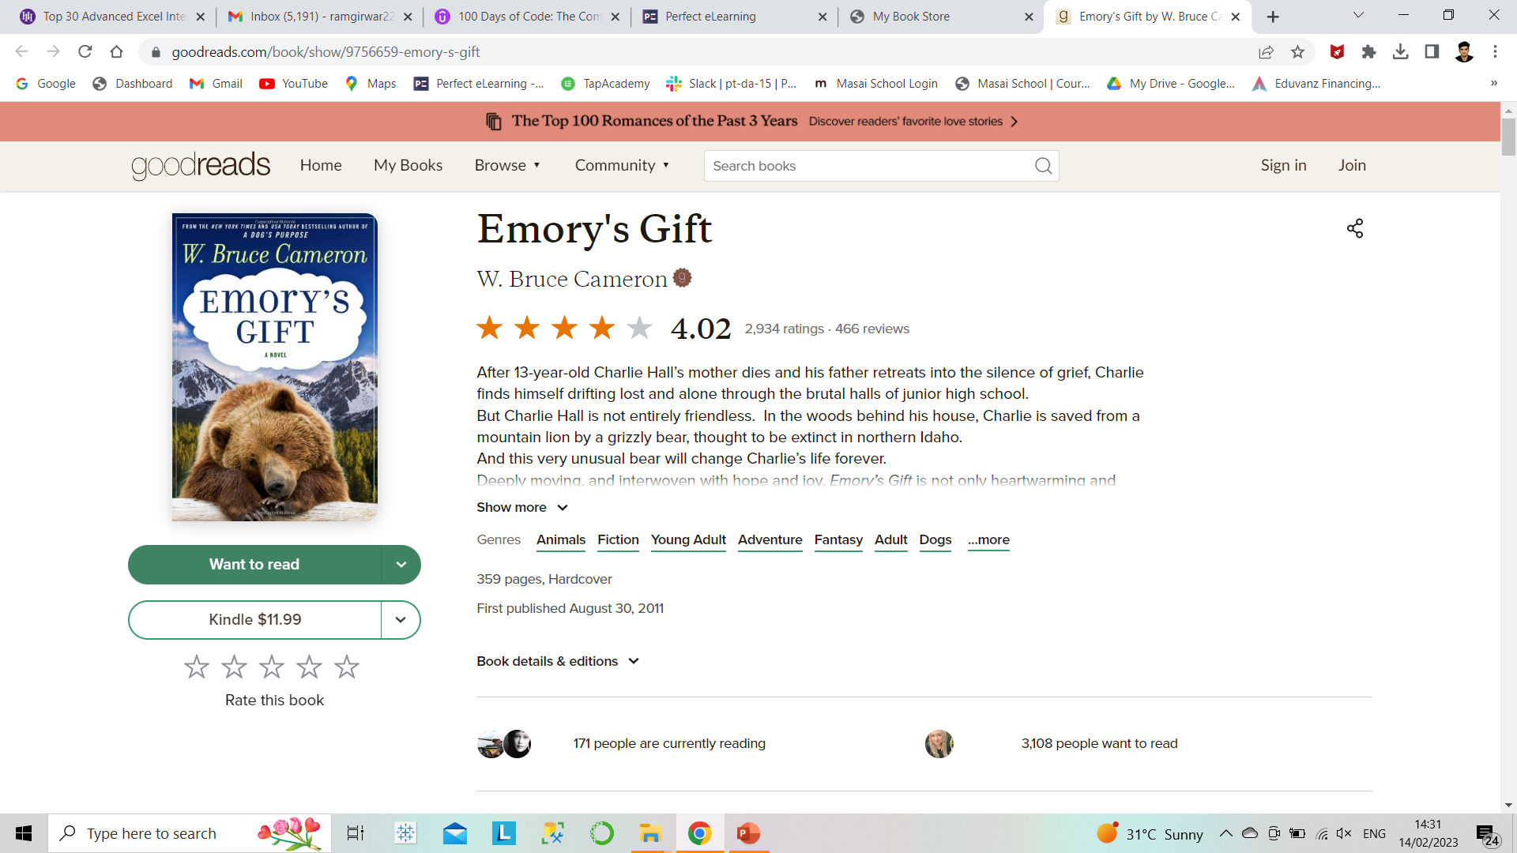
Books Detail
Redirected parent page with more information
Click on more info button for redirecting to book information page

Slide 9
Important link
http://ramgirwar22.pythonanywhere.com (website link)

Slide 10
Thank You..!

